Slide 1
Ali Khalid (ak5013@rit.edu)
Muhammad Raees (mr2714@rit.edu)
Cyberinfrastructure Foundations
Project Presentation
Change Detection in
3D LiDAR Data

Slide 2
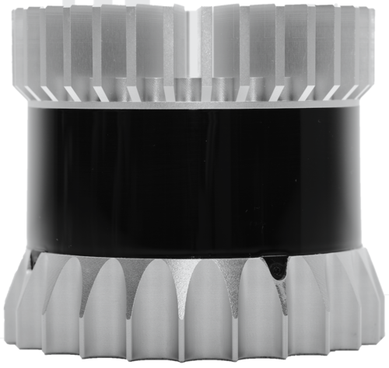
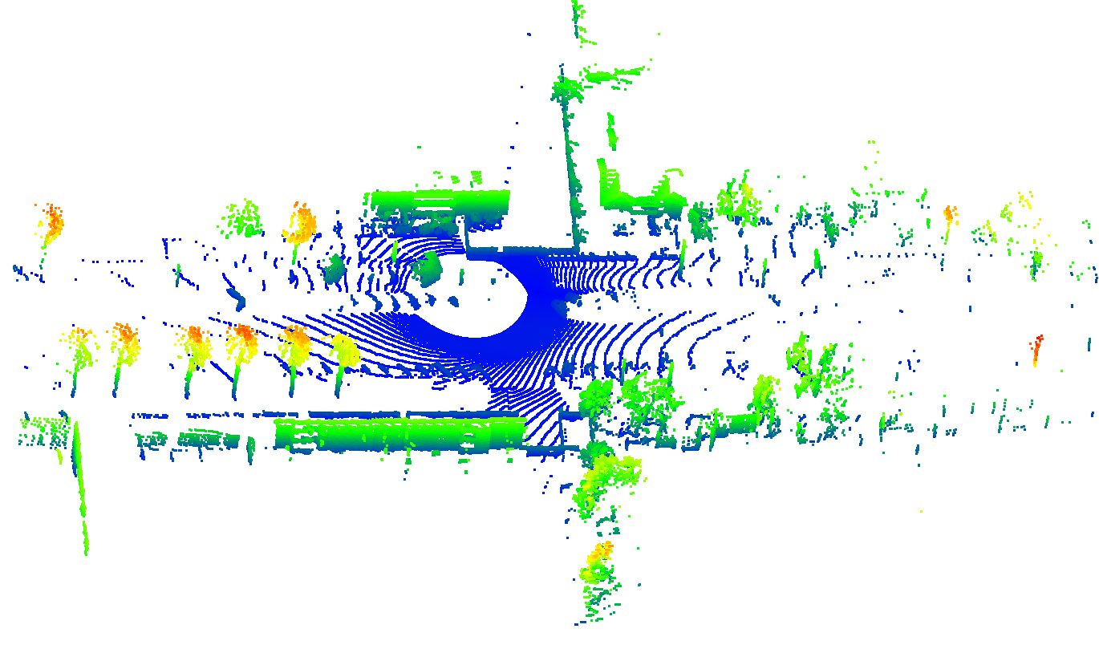
LiDAR
Sequence of Point Clouds (PCDs)
Each PCD (frame) consists of 3D Points:
position (x, y, and z)
Intensity
Color (RGB)
LiDAR
3D point cloud
Notes:
The data generated by lidar is called point cloud. each point cloud consist of 3D points. these points are defined by there x, y,z positions and in some cases the have additional attributes like color, intensity etc. A sample point cloud captured by lidar installed on an autonomous vehicle is shown below. The blue color represents road, green color represents the sidewalk etc.

Slide 3

Change Detection
Autonomous Vehicle
3D Map of Area
Change detected by AV
Notes:
Autonomous vehicles use 3D map of the environment to localize themselves. An up to date 3D map of the environment is necessary for safe and accurate operations of AVs. for this purpose we need to find the changes in the environment and update the basemap to reflect these changes. The video above shows the change detected in basemap by AVs as it moves from left to right. The Red color represents the points which are not changed. On the other hand green color represents the changed point.

Slide 4
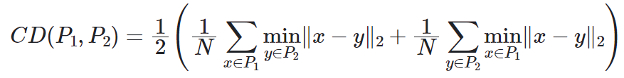
Similarity Measure
Chamfer Distance:
A quantitative measure of the discrepancy between two shapes represented by point clouds.
The smaller the value of CD, the similar the point clouds and vice versa.
Notes:
There are various methods to find the change. One method is to use similarity measure like Chamfer distance. Chamfer distance is the average distance of each point in each cloud to the closest point in the other cloud. The smaller value of Chamfer distance shows that clouds are same while the larger value indicates that clouds are very different.. Autonomous Vehicle has limited time (usually 100ms) to complete the perception pipeline for one point cloud. Change detection is only a small portion of perception pipeline, therefore it needs to be very fast.

Slide 5
Chamfer Distance
Point Cloud 1
Point Cloud 2
Notes:
Now the question is how to find this change efficiently. Assume that we have two point clouds, shown by green and red color here.

Slide 6
Chamfer Distance
Point Cloud 1
Point Cloud 2
Find distance from all the points in other point cloud
Notes:
We find the distance for a point in red point cloud to all the points in green point cloud.

Slide 7
Chamfer Distance
Point Cloud 1
Point Cloud 2
Find the shortest distance
Notes:
and then select the minimum distance and save it in memory.

Slide 8
Chamfer Distance
Point Cloud 1
Point Cloud 2
Repeat the process for all the points in the two point clouds
Notes:
After that we repeat the process for each point in the point cloud.

Slide 9
Chamfer Distance
Point Cloud 1
Point Cloud 2
Repeat the process for all the points in the two point clouds
Parallelizable !
Notes:
the process of finding the shortest distance of each point in each point cloud is independent and hence can be run in parallel.

Slide 10
Methods
Baseline
It represents the simplest implementation (as above)
This is our standard reference point for comparison
Baseline Openmp
Parallelization applied with multithreading
Baseline GPU
Implementation with GPU
Block size = 256
Number of blocks = point cloud size / block size
Notes:
we implement different methods to calculate the chamfer distance between two point clouds. The first one is standard reference point. The results from this methods are used to test the accuracy of other methods. Moreover this method also serves as the baseline. In the second method we parallelize the same implementation using OpenMP. The number of threads on CPU are limited. Therefore in our third method we use GPU to perform parallelization. In this method we have one thread for each point. We keep the block size fix to 256 and then decide the number of blocks according the size of PCD. Although GPU implementation is fast but still its a computationally expensive.

Slide 11
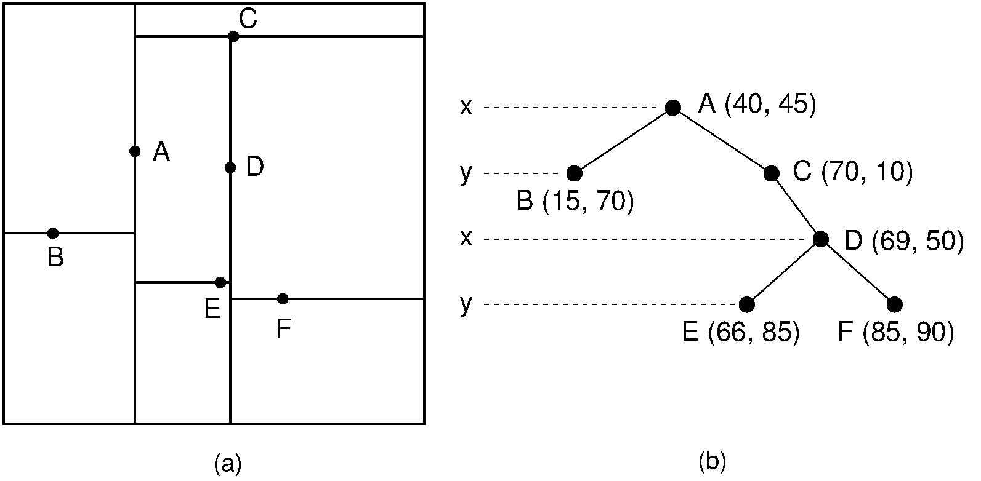
Methods
What is KD-tree?
KD-tree (short for k-dimensional tree) is a space-partitioning data structure for organizing points in a k-dimensional space.
KD-tree for 2 dimensions shown below.
https://opendsa-server.cs.vt.edu/ODSA/Books/CS3/html/KDtree.html
https://en.wikipedia.org/wiki/K-d_tree
Notes:
Instead of finding the shortest distance with brute force comparison, we decided to use KD tree structure. The spatial tree structures Kdtree are really efficient in finding nearest neighbor for low low dimensional data. KD tree divides the space and organizes data points in it. An example KD tree for 2 dimension and corresponding space partitioning is shown here. The dividing plane at each layer is orthogonal to its parent plane.

Slide 12
Methods
KD-tree
Construct KD-tree (large PC) and then find nearest neighbor search to the query point
KD-tree Openmp
Multithreaded KD-Tree
KD-tree GPU
GPU-based KD-tree search (in progress)
Notes:
We then implemented the Chamfer distance calculation using KD trees. Moreover we also used OMP with KD tree to make it even faster. We also tried implementing KDtree solution with GPU, but we are facing some issues and that implementation is not ready yet.

Slide 13
Implementation
Code base (C++)
Data generator
Implementation of each method
Bash files to automate the process of
Data generation
Compilation
Testing
Libraries
PCL (Point Cloud Library)
Notes:
all of our code base including sample data generator is in C++. we have separate executable for each method. We also have bash files to automate the process of data generation, compilation and testing. We only used one external library in our implementation, know as Point Cloud Library.

Slide 14
Results
Machine Description
Intel Core i9 12900h (14 cores, 20 Threads, 5Ghz)
NVIDIA GeForce RTX 3070 Ti
16GB DDR5
Sr. | Method | Points Processed in Seconds
 |  | 1000 | 10000 | 100000 | 1000000
1 | Baseline | 0.004 | 0.226 | 20.510 | 2164.709
2 | Baseline Openmp | 0.011 | 0.054 | 4.082 | 398.410
3 | Baseline GPU | 0.051 | 0.058 | 0.194 | 7.419
4 | KD-Tree | 0.003 | 0.003 | 0.222 | 2.579
5 | KD-Tree Openmp | 0.004 | 0.004 | 0.107 | 1.240
Notes:
we rana all the tests on a local PC with intel core i9 CPU. this CPU has 14 cores and support 20 threads at max with hyper threading. It also has NVIDIA GeForce RTX 3070 Ti GPU. Moreover it has 16 GB DDR5 ram.

Slide 15
DEMO
(for 100000 points)
Notes:
now will show the demo for 100 thousands point.

Slide 16
Thank you!

